Slide 1

Zwilling IOE: A Comprehensive Solution for Process Optimization
Zwilling IOE is a powerful on premise solution designed to optimize industrial processes. The solution captures real-time process parameters, leverages AI-powered analytics, and delivers actionable insights for continuous improvement.

Slide 2
Key Stakeholders and Ownership
Zwilling Labs develops and maintains Zwilling IOE, while KMT takes ownership of technical implementation and project management.
Technical Implementation
Project Ownership
KMT will handle the technical aspects of integrating Zwilling IOE into their existing infrastructure.
KMT will be responsible for project management, including defining scope, timelines, and resource allocation.

Slide 3

Solution Specifications
Zwilling IOE is delivered as a on premise solution, providing a flexible model tailored to KMT's specific needs.
On Premise Delivery
Users access Zwilling IOE through a web interface, eliminating the need for local software installations.

Slide 4
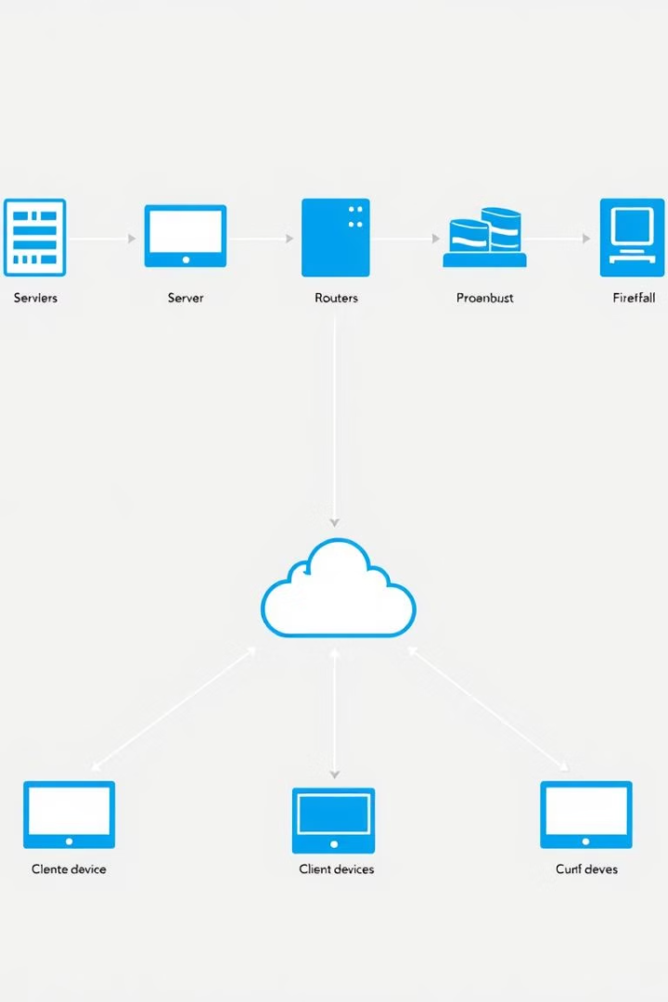
IT Requirements
The IT requirements for implementing Zwilling IOE are carefully considered to ensure smooth integration and optimal performance.
1
Hardware Support
The specific hardware requirements will be determined based on the scale of KMT's operation and the data volumes to be processed.
2
Software Support
Compatibility with various operating systems for both mobile and desktop devices, including browser compatibility, is essential.
3
Infrastructure Support
Firewall configuration, IP address and email domain whitelisting, and endpoint setup are crucial for secure connectivity.
4
Supporting Diagrams
Detailed network architecture and data-flow maps will be provided after thorough discussions to ensure seamless integration.

Slide 5
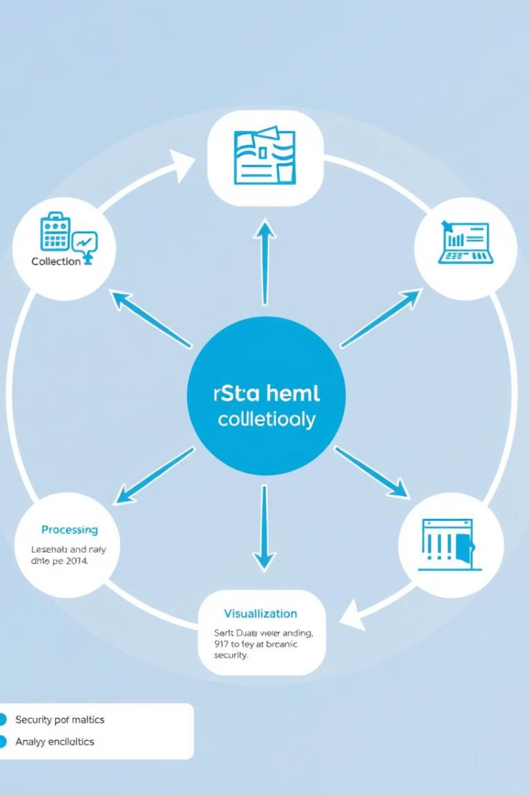
Data Handling and Security
Zwilling IOE prioritizes data security and ensures responsible data handling throughout the entire lifecycle.
Data Collected
Process parameters like machine speed, load, and other relevant metrics.
Data Transfer
Data is transferred via secure dashboards designed to facilitate business decision-making.
User Management
Role-based access control is implemented with defined permissions for operators, supervisors, and plant managers.
Data Storage
Data is stored securely on Zwilling Labs servers hosted on AWS, ensuring data integrity and compliance.
Access Control
Access is restricted to authorized KMT teams, with strong password protection enforced for enhanced security.
Integration Support
Single Sign-On (SSO) and Multi-Factor Authentication (MFA) can be implemented to meet KMT's specific security requirements.

Slide 6






Security and Compliance
Zwilling IOE adheres to industry best practices for data encryption, access control, and compliance with relevant regulations.
Data Encryption
Data is encrypted both at rest and in transit, ensuring robust protection against unauthorized access.
Vendor Access
Zwilling Labs has controlled access to data for AI model development, subject to strict protocols.
Data Transfer Protocols
Secure data transfer protocols are employed to ensure the integrity and confidentiality of sensitive information.
Data Protection
Encryption and secure disposal practices are implemented to protect data throughout its lifecycle.
Software Updates
Hardware updates are handled by the Zwilling Labs team, while software updates are provided to KMT IT for installation.
Log Monitoring
Zwilling IOE can be configured to forward logs to Azure Sentinel for comprehensive security monitoring.

Slide 7



Compliance and Regulations
Zwilling IOE complies with relevant data privacy and industry regulations to ensure responsible data handling.
Data Privacy
Industry Standards
Zwilling IOE adheres to GDPR and other relevant privacy regulations, ensuring data protection and responsible use.
Zwilling IOE adheres to industry standards for data security and compliance, ensuring robust protection and responsible data handling.

Slide 8

Risk Management
Zwilling IOE implements robust risk management strategies to mitigate potential data security risks and disruptions.
1
Data Security Risks
Unauthorized access is mitigated through NDA agreements, while vendor protocols prevent data modification or destruction.
2
Access Disruption
Vendor protocols and disaster recovery plans are in place to minimize the impact of access disruption.

